Slide 1


Slide 2
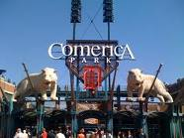
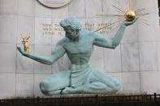
Prayer Walk
Comerica Park to Spirit of Detroit
Saturday, April 28
9:00 a.m.
Rain or Shine
Wear your 2WordStory gear!

Slide 3



Connect to the Movement
Sign-up at EACHtoday.com

Slide 4


Online store is open!
Get your gear for the Prayer Walk…
Share your story starting Easter Sunday!

Slide 5
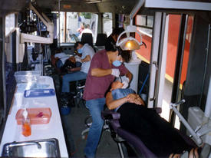
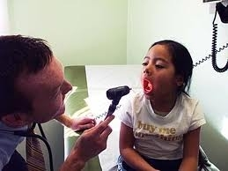
“Mobile Medical and Dental Trailers”
Medical and Non-Medical Servants Needed!

Slide 6
“Life Remodeled”
Building 6 New Homes
Giving 6 Families a New Start
Skilled Trades People and Servants Needed!

Slide 7
“Handyman Ministries”
40 Homes Repaired and Renovated
2 Detroit Communities
Skilled trades people and servants needed!

Slide 8
“Daily Bread Feeding Program”
Food Pick-up and Delivery
Food Distribution
Ministry
Drivers and Ministers (that’s you) needed!

Slide 9
“Nehemiah Projects”
20 EACH Ministry Partners
Faithful Servants Needed
Find what you love to do and get plugged in!

Slide 10
“Nehemiah Audio Prayer Journey”
Beginning Monday, April 9
40 days of prayer. 40 pastors share. iTunes, Daily emails,
EACH and 2WordStory Facebook pages

Slide 11
Lovin’ the “D”
Resource Fair and Outreach Event
Saturday, May 19
1o a.m. – 4:00 p.m.
Wayne State University Athletic Fields
Free day of fun for all!

